Slide 1
Motion estimation

Slide 2
Why estimate visual motion?
Visual Motion can be annoying
Camera instabilities, jitter
Measure it; remove it (stabilize)
Visual Motion indicates dynamics in the scene
Moving objects, behavior
Track objects and analyze trajectories
Visual Motion reveals spatial layout
Motion parallax

Slide 3
Readings
Szeliski, R. CVAA
Ch. 7.1, 7.2, 7.4
Bergen et al. Hierarchical model-based motion estimation. ECCV’92, pp. 237–252.
Shi, J. and Tomasi, C. (1994). Good features to track. In CVPR’94, pp. 593–600.
Baker, S. and Matthews, I. (2004). Lucas-kanade 20 years on: A unifying framework. IJCV, 56(3), 221–255.

Slide 4
Classes of Techniques
Feature-based methods
Extract visual features (corners, textured areas) and track them
Sparse motion fields, but possibly robust tracking
Suitable especially when image motion is large (10s of pixels)
Direct-methods
Directly recover image motion from spatio-temporal image brightness variations
Global motion parameters directly recovered without an intermediate feature motion calculation
Dense motion fields, but more sensitive to appearance variations
Suitable for video and when image motion is small (< 10 pixels)

Slide 5
Optic Flow Computation
Two strategies for computing motion
Differential Methods
Spatio temporal derivatives for estimation of flow at every position
Multi-scale analysis required if motion not constrained within a small range
Dense flow measurements
Matching Methods
Feature extraction(Image edges, corners)
Feature/Block Matching and error minimization
Sparse flow measurements
Courtesy: E. Trucco and A. Verri, “Introductory techniques for 3D Computer Vision”

Slide 6
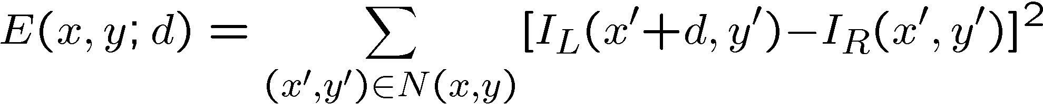
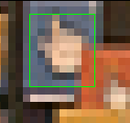
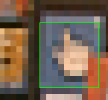
Patch matching (revisited)
How do we determine correspondences?
block matching or SSD (sum squared differences)
Notes:
The key to image mosaicing is how to register two images.
And the simplest case for image registration is block matching, or estimating the translational motion between two images. Suppose a template (for example, the green box) or even the whole image moves with the same translation, we can estimate the motion by minimize the squared difference between two images. For instance, we can search the minimum squared error by shifting the template window around its neighborhood.

Slide 7
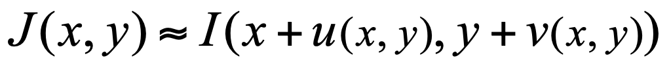

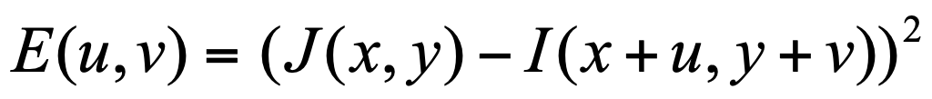
The Brightness Constraint
Brightness Constancy Equation:
Or, equivalently, minimize :
Linearizing (assuming small (u,v)) using Taylor series expansion:

Slide 8
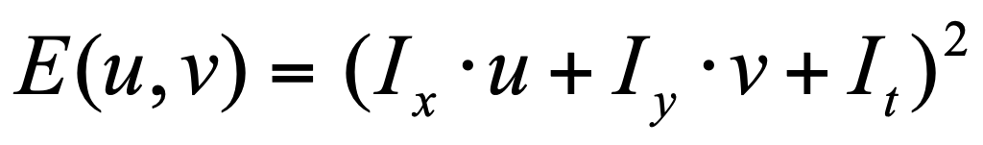
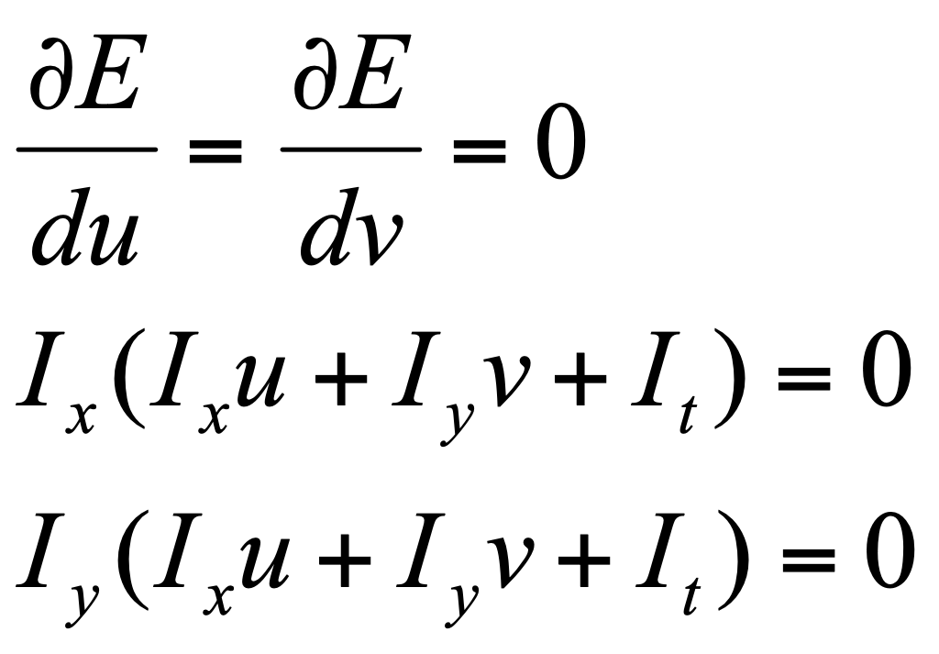
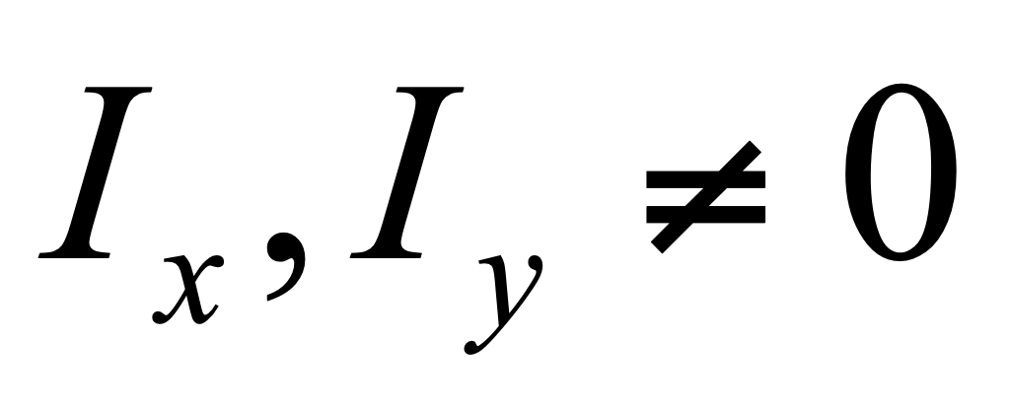
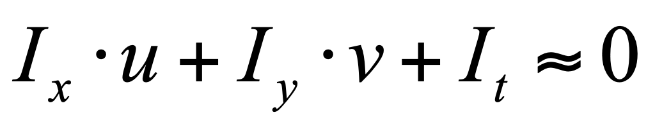
Gradient Constraint (or the Optical Flow Constraint)
Lucas-Kanade method
Minimizing:
In general
Hence,

Slide 23
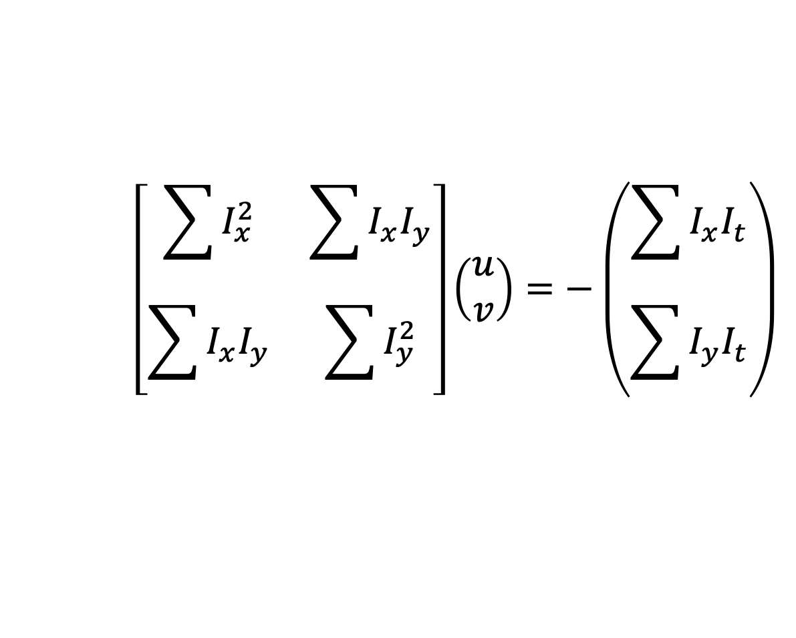
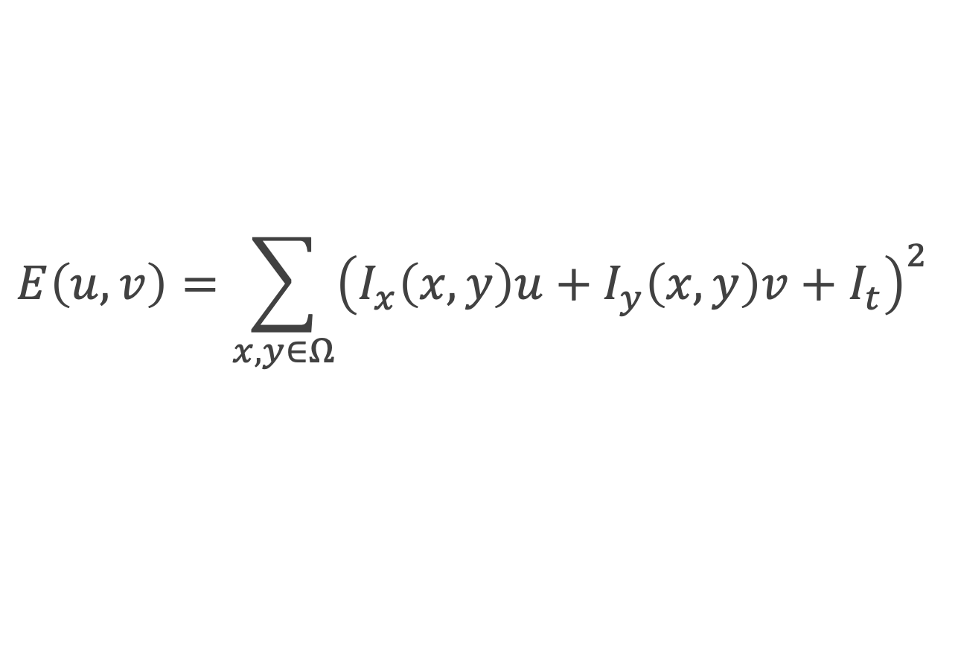
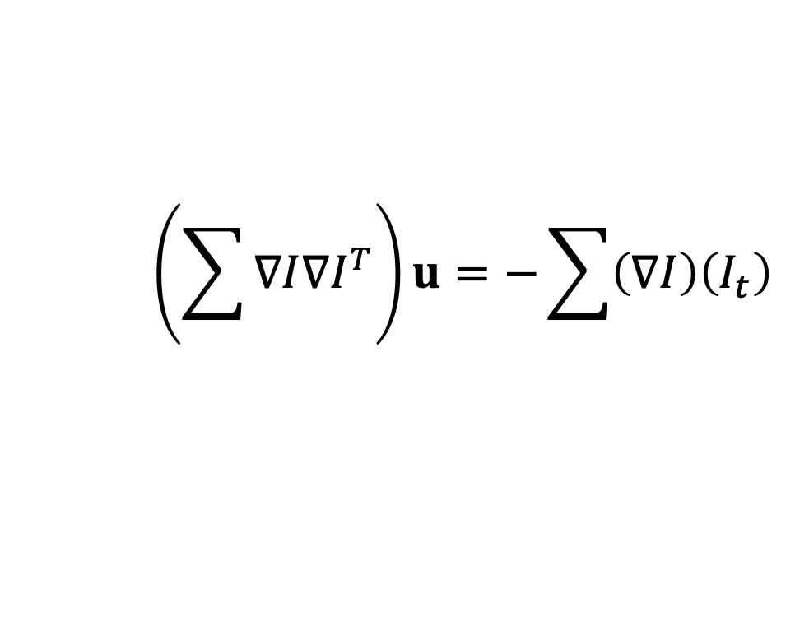
Patch Translation [Lucas-Kanade]
Assume a single velocity for all pixels within an image patch
$$E\left(u,v\right)=\sum_{x,y∈Ω}{{\left(I_{x}\left(x,y\right)u+I_{y}\left(x,y\right)v+I_{t}\right)}^{2}}$$
Minimizing
$$\left[\begin{matrix}\sum{I_{x}^{2}} & \sum{I_{x}I_{y}} \\ \sum{I_{x}I_{y}} & \sum{I_{y}^{2}}\end{matrix}\right]\left(\begin{matrix}u \\ v\end{matrix}\right)=−\left(\begin{matrix}\sum{I_{x}I_{t}} \\ \sum{I_{y}I_{t}}\end{matrix}\right)$$
$$\left(\sum{∇I∇I^{T}}\right)u=−\sum{\left(∇I\right)\left(I_{t}\right)}$$
LHS: sum of the 2x2 outer product of the gradient vector

Slide 24
Local Patch Analysis
How certain are the motion estimates?

Slide 25
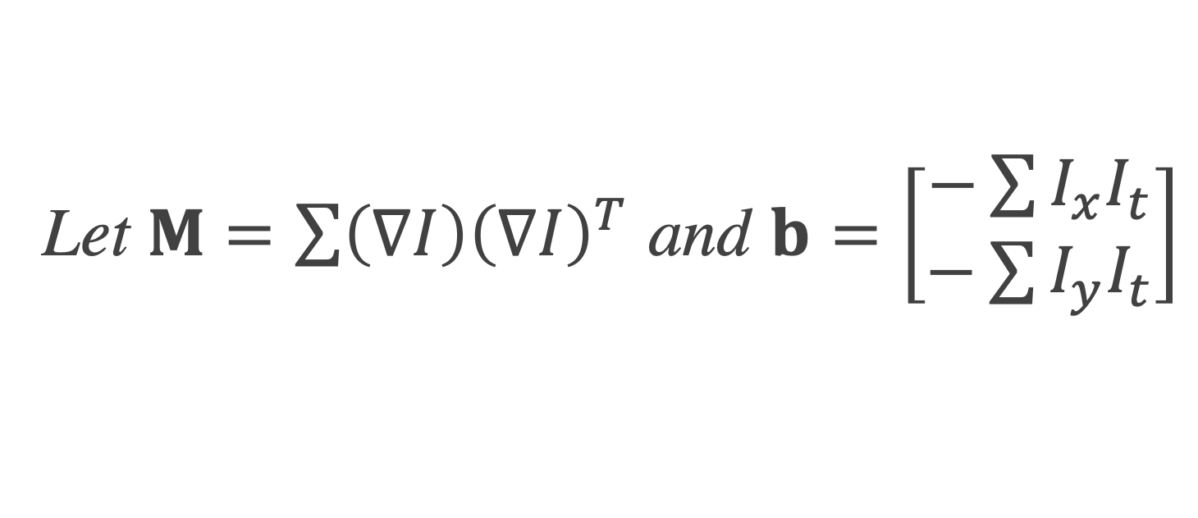
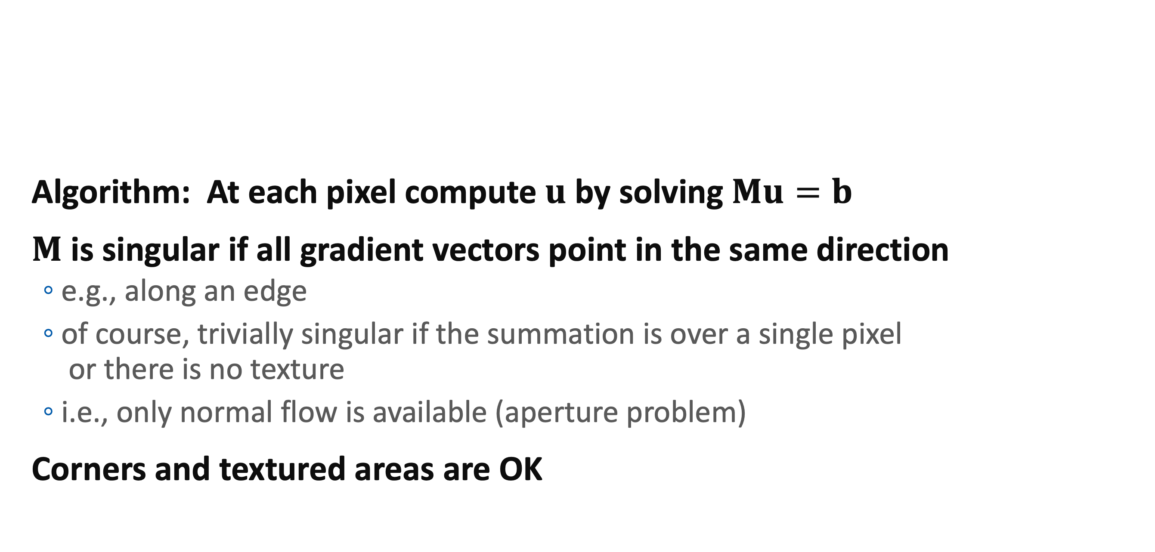
The Aperture Problem
Algorithm: At each pixel compute $u$ by solving $Mu=b$
$M$ is singular if all gradient vectors point in the same direction
e.g., along an edge
of course, trivially singular if the summation is over a single pixel or there is no texture
i.e., only normal flow is available (aperture problem)
Corners and textured areas are OK
Let $M=\sum{\left(∇I\right){\left(∇I\right)}^{T}}$ and $b=\left[\begin{matrix}−\sum{I_{x}I_{t}} \\ −\sum{I_{y}I_{t}}\end{matrix}\right]$

Slide 26
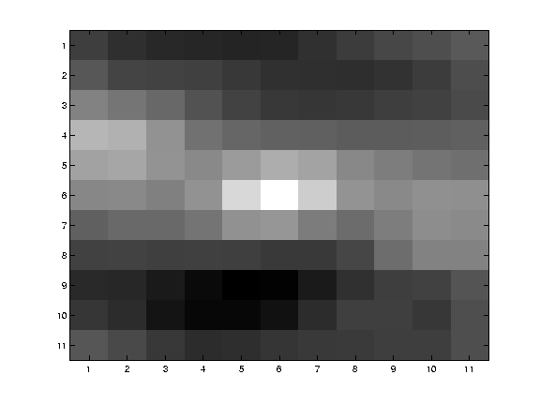
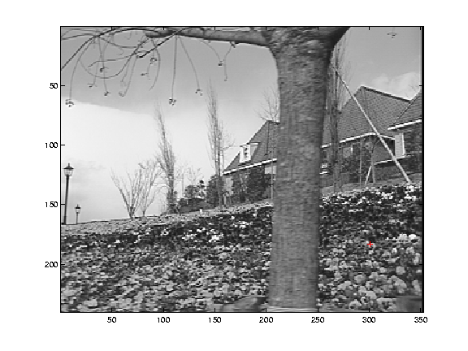
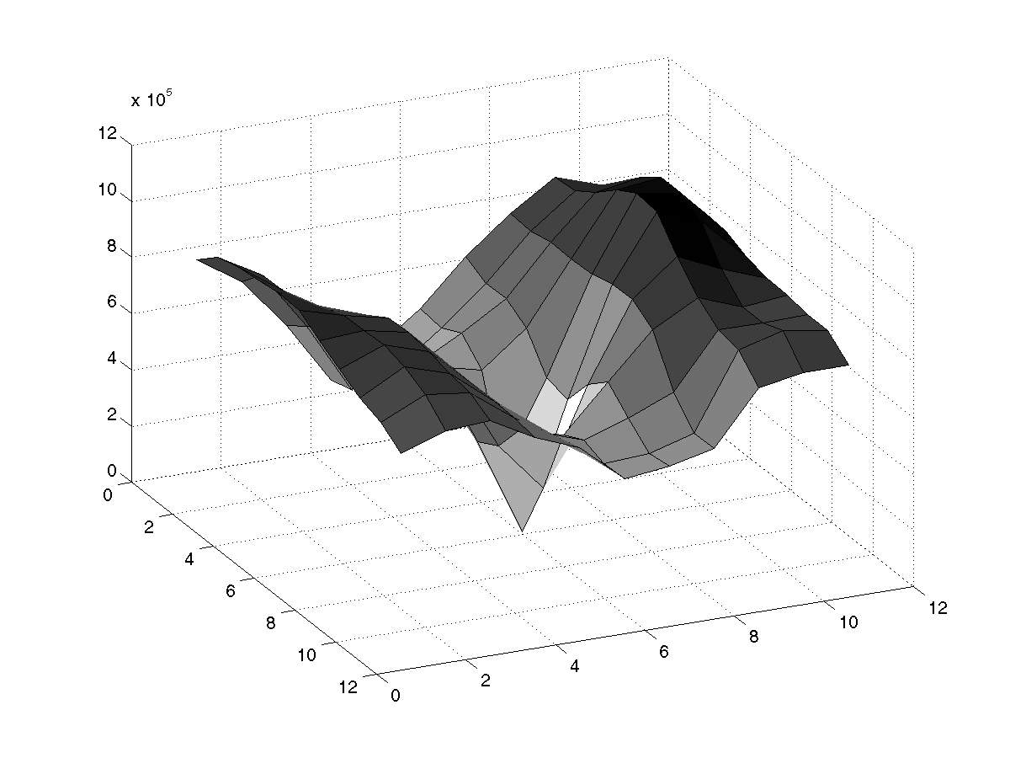
SSD Surface – Textured area

Slide 27
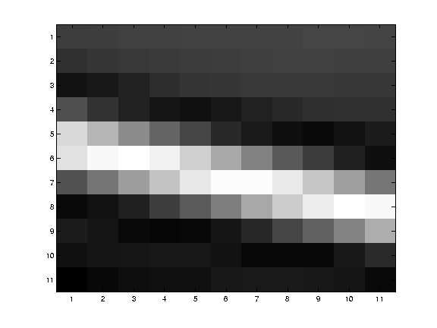
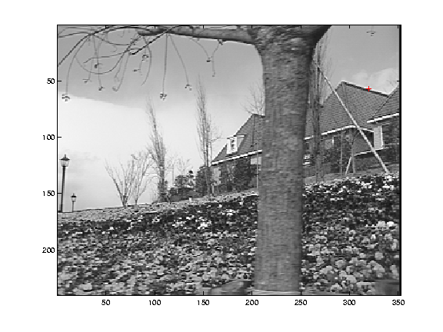
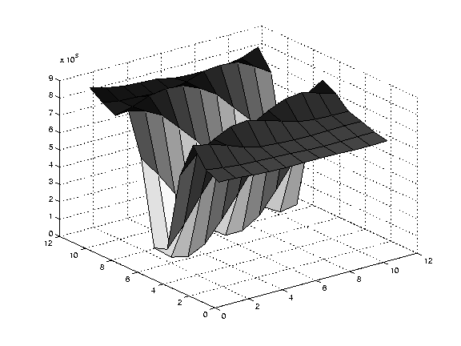
SSD Surface -- Edge

Slide 28
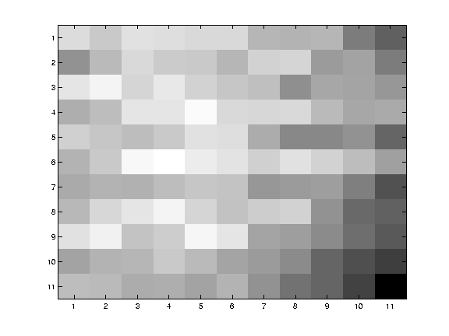
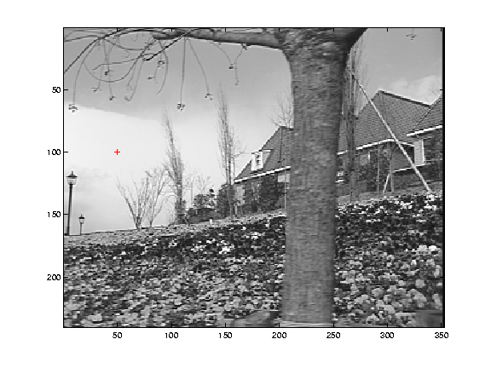
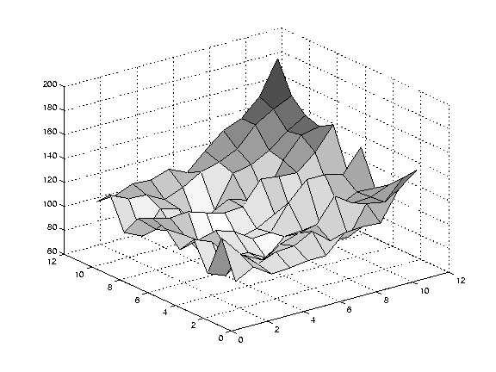
SSD – homogeneous area

Slide 29
Iterative Refinement
Estimate velocity at each pixel using one iteration of Lucas and Kanade estimation
Warp one image toward the other using the estimated flow field
(easier said than done)
Refine estimate by repeating the process

Slide 30
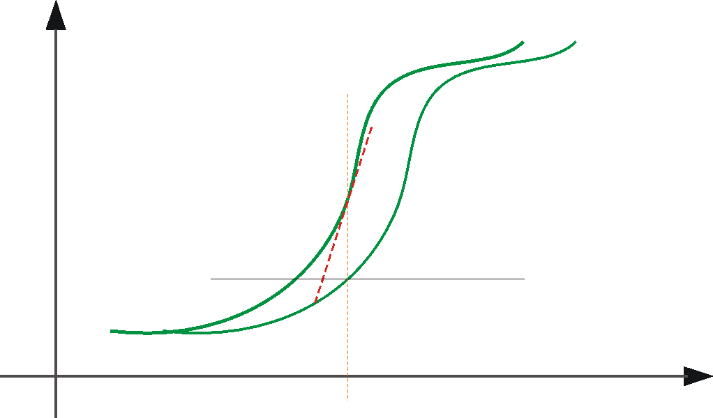
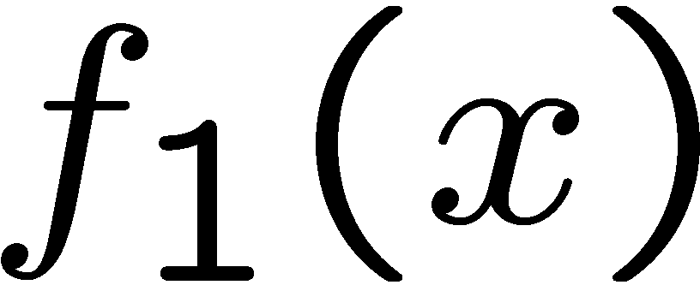
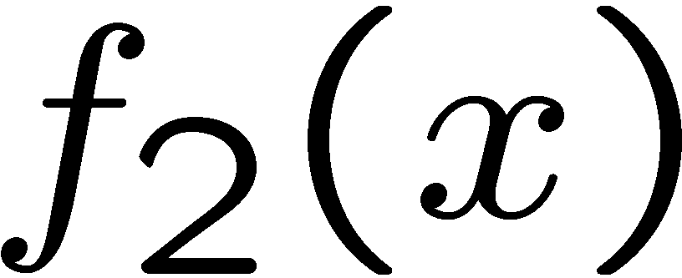


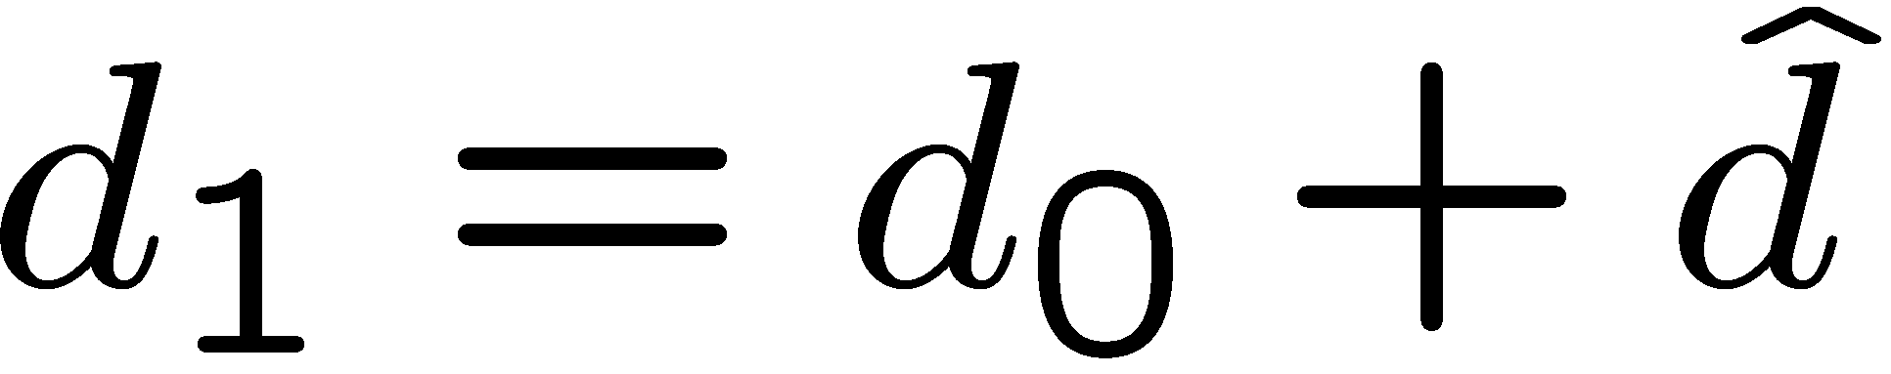
Optical Flow: Iterative Estimation
estimate update
Initial guess:
Estimate:
x
x0
(using d for displacement here instead of u)

Slide 31
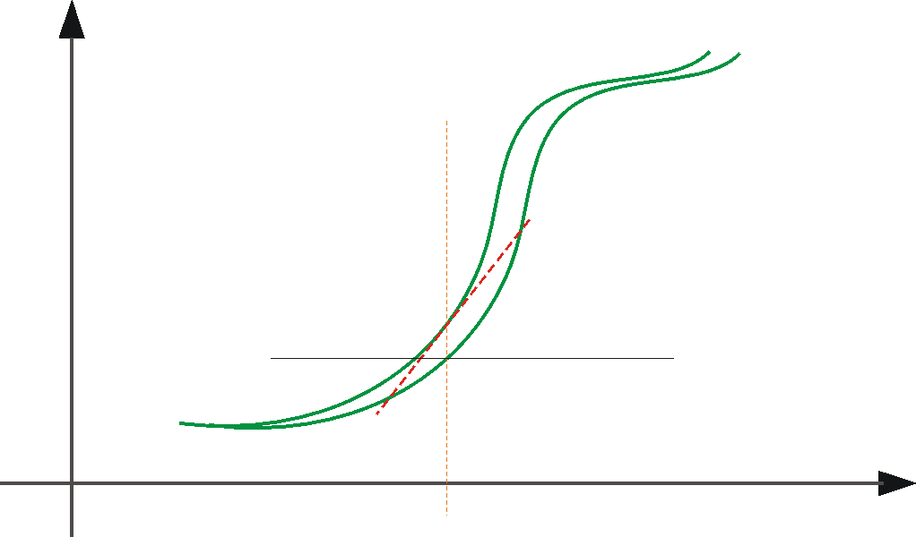
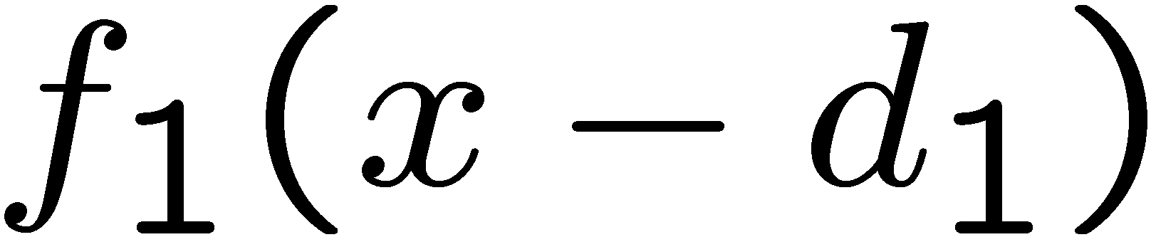
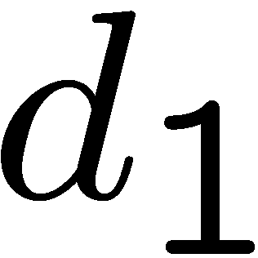
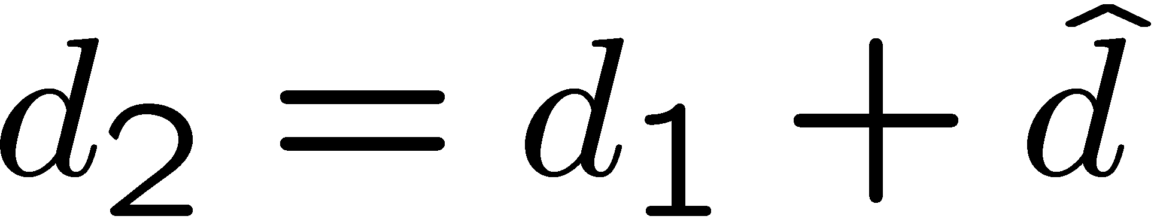
Optical Flow: Iterative Estimation
estimate update
Initial guess:
Estimate:
x
x0

Slide 32
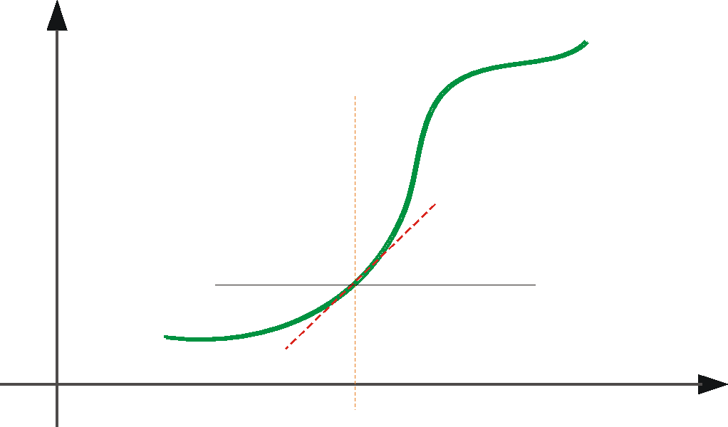
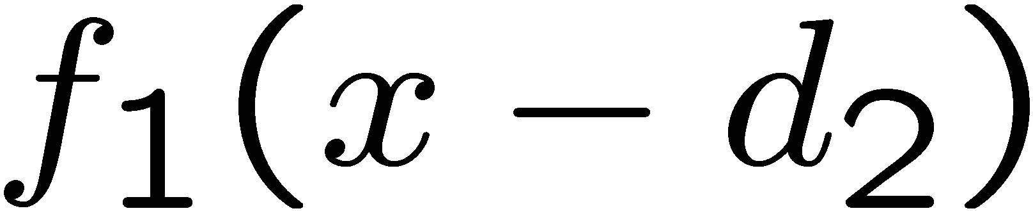
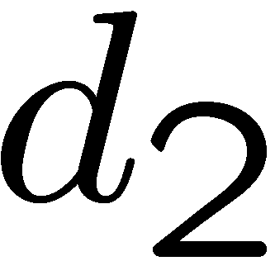
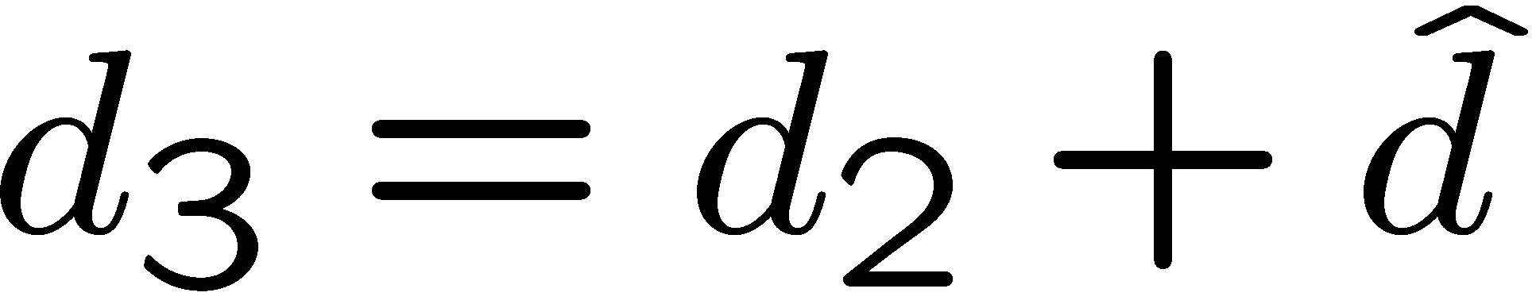
Optical Flow: Iterative Estimation
estimate update
Initial guess:
Estimate:
Initial guess:
Estimate:
x
x0

Slide 33
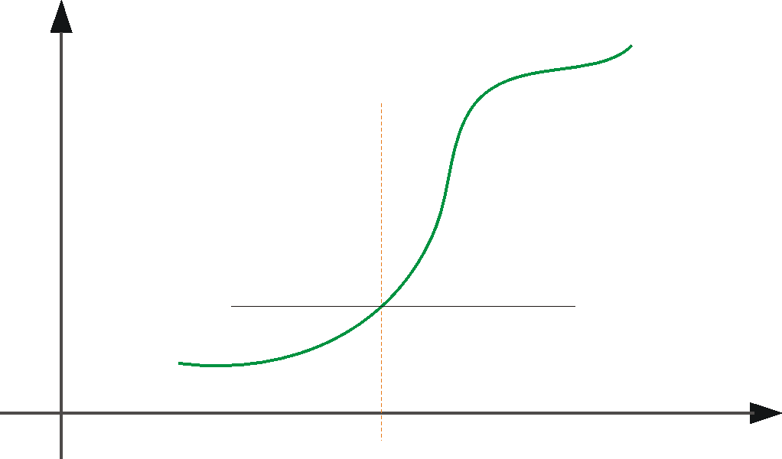
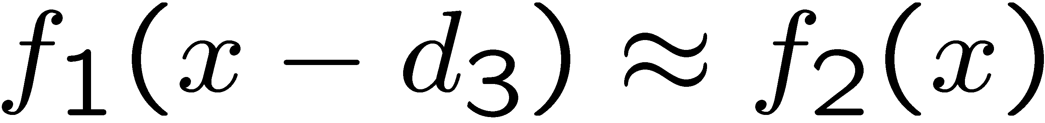
Optical Flow: Iterative Estimation
x
x0

Slide 34
Optical Flow: Iterative Estimation
Some Implementation Issues:
Warping is not easy (ensure that errors in warping are smaller than the estimate refinement)
Warp one image, take derivatives of the other so you don’t need to re-compute the gradient after each iteration.
Often useful to low-pass filter the images before motion estimation (for better derivative estimation, and linear approximations to image intensity)

Slide 35
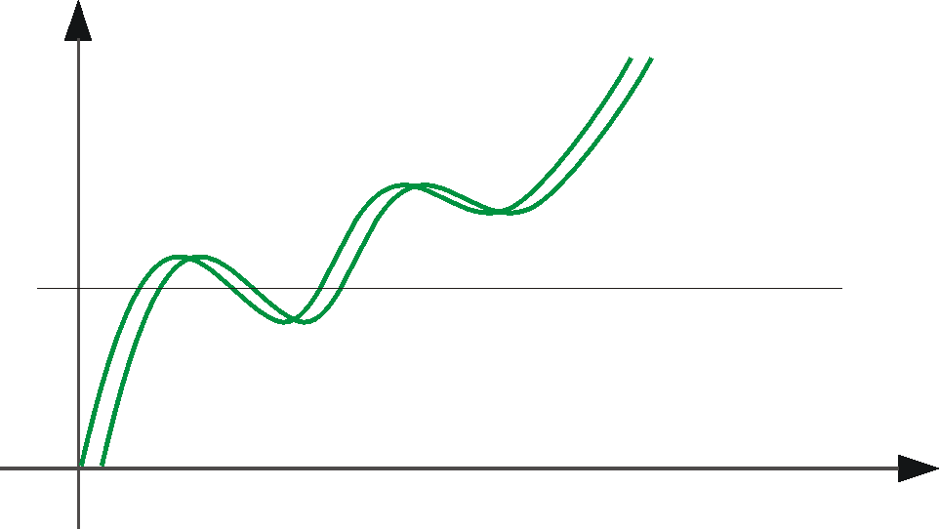
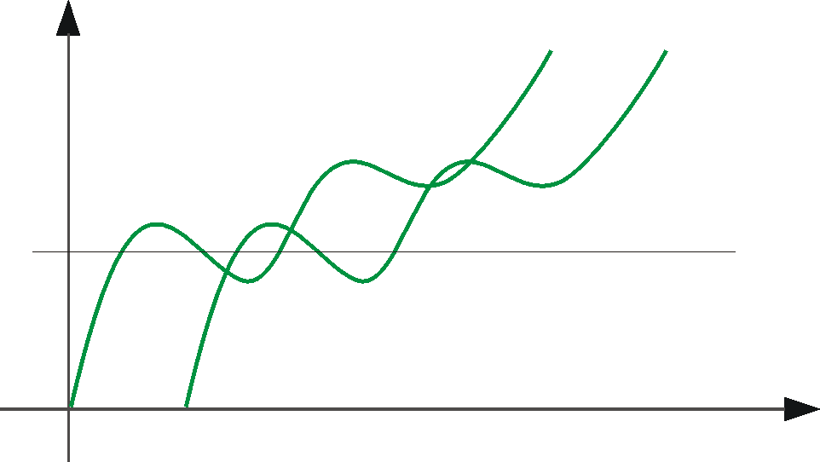
Optical Flow: Aliasing
Temporal aliasing causes ambiguities in optical flow because images can have many pixels with the same intensity.
I.e., how do we know which ‘correspondence’ is correct?
To overcome aliasing: coarse-to-fine estimation.
actual shift
estimated shift
nearest match is correct (no aliasing)
nearest match is incorrect (aliasing)

Slide 36
Limits of the gradient method
Fails when intensity structure in window is poor
Fails when the displacement is large (typical operating range is motion of 1 pixel)
Linearization of brightness is suitable only for small displacements
Also, brightness is not strictly constant in images
actually less problematic than it appears, since we can pre-filter images to make them look similar

Slide 37

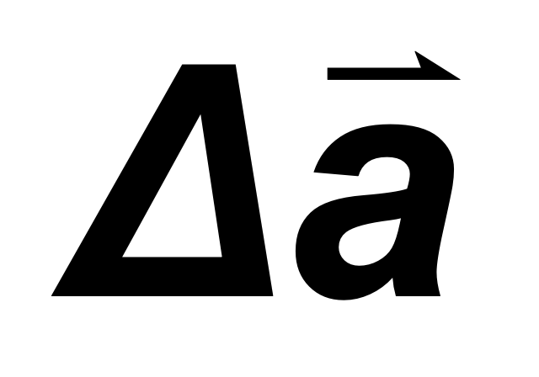
Coarse-to-Fine Estimation
warp
Jw
refine
u=1.25 pixels
+
u=2.5 pixels
u=5 pixels
image J
image I
u=10 pixels
Pyramid of image J
Pyramid of image I

Slide 38
Parametric motion estimation

Slide 39
Global (parametric) motion models
2D Models:
Affine
Quadratic
Planar projective transform (Homography)
3D Models:
Instantaneous camera motion models
Homography+epipole
Plane+Parallax

Slide 40
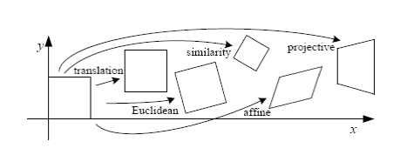
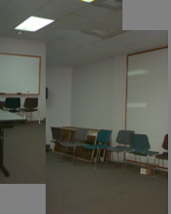
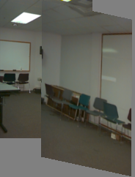
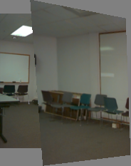
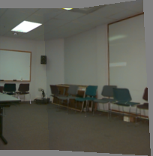
Motion models
Translation
Affine
Perspective
3D rotation
2 unknowns
6 unknowns
8 unknowns
3 unknowns

Slide 41
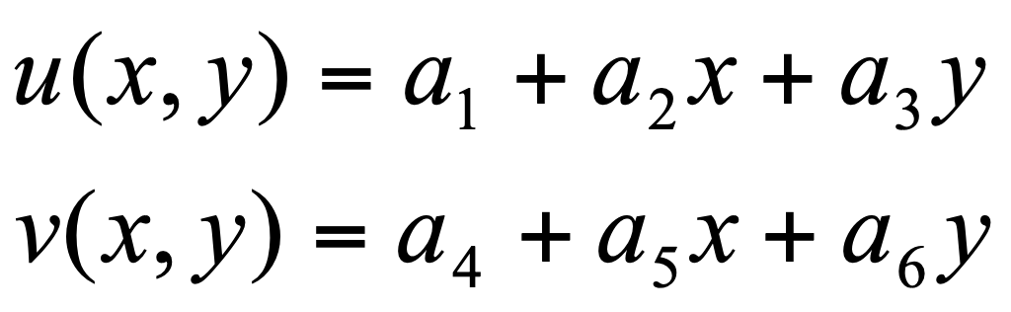
Example: Affine Motion
Substituting into the B.C. Equation:
Each pixel provides 1 linear constraint in 6 global unknowns
Least Square Minimization (over all pixels):

Slide 42
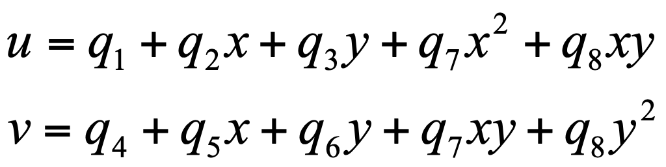
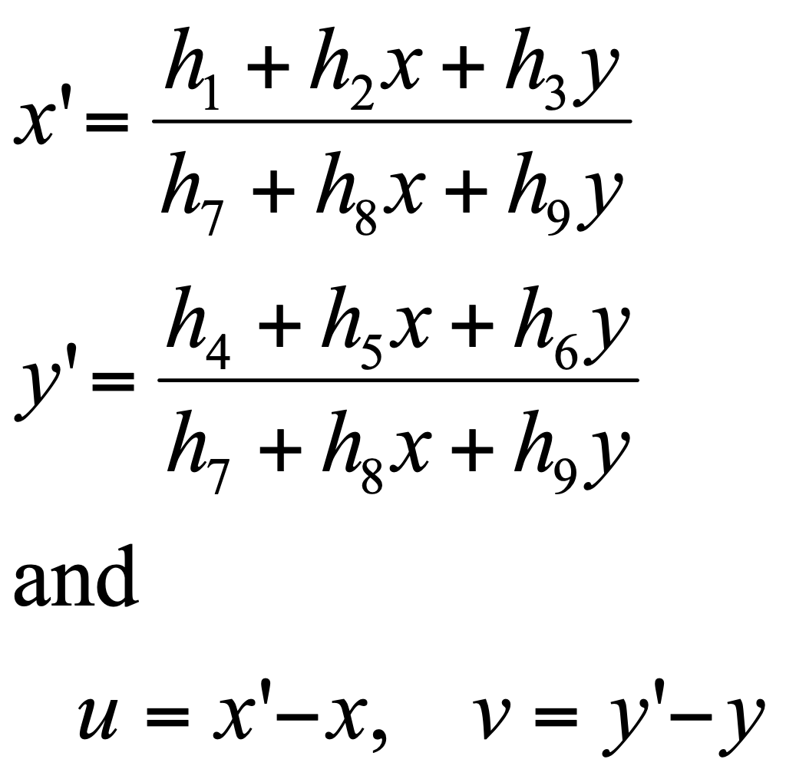
Other 2D Motion Models
Quadratic – instantaneous approximation to planar motion
Projective – exact planar motion

Slide 43
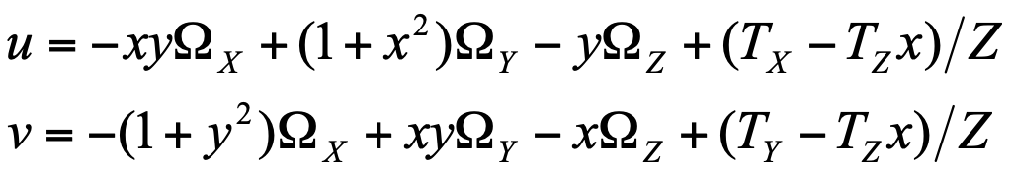
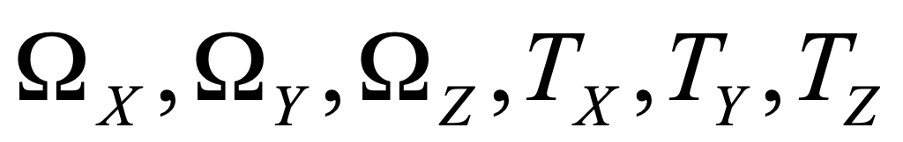






3D Motion Models
Instantaneous camera motion:
Global parameters:
Local Parameter:
Homography+Epipole
Global parameters:
Local Parameter:
Residual Planar Parallax Motion
Global parameters:
Local Parameter:

Slide 44
Patch matching (revisited)
How do we determine correspondences?
block matching or SSD (sum squared differences)
Notes:
The key to image mosaicing is how to register two images.
And the simplest case for image registration is block matching, or estimating the translational motion between two images. Suppose a template (for example, the green box) or even the whole image moves with the same translation, we can estimate the motion by minimize the squared difference between two images. For instance, we can search the minimum squared error by shifting the template window around its neighborhood.

Slide 45
Correlation and SSD
For larger displacements, do template matching
Define a small area around a pixel as the template
Match the template against each pixel within a search area in next image.
Use a match measure such as correlation, normalized correlation, or sum-of-squares difference
Choose the maximum (or minimum) as the match
Sub-pixel estimate (Lucas-Kanade)

Slide 46



Discrete Search vs. Gradient Based
Consider image I translated by $u_{0}, v_{0}$
The discrete search method simply searches for the best estimate.
The gradient method linearizes the intensity function and solves for the estimate

Slide 47
Shi-Tomasi feature tracker
Find good features (min eigenvalue of 2×2 Hessian)
Use Lucas-Kanade to track with pure translation
Use affine registration with first feature patch
Terminate tracks whose dissimilarity gets too large
Start new tracks when needed

Slide 48

Tracking results

Slide 49

Tracking - dissimilarity

Slide 50

Tracking results

Slide 51
Correlation Window Size
Small windows lead to more false matches
Large windows are better this way, but…
Neighboring flow vectors will be more correlated (since the template windows have more in common)
Flow resolution also lower (same reason)
More expensive to compute
Small windows are good for local search:
more detailed and less smooth (noisy?)
Large windows good for global search:
less detailed and smoother

Slide 52


Robust Estimation
Noise distributions are often non-Gaussian, having much heavier tails. Noise samples from the tails are called outliers.
Sources of outliers (multiple motions):
specularities / highlights
jpeg artifacts / interlacing / motion blur
multiple motions (occlusion boundaries, transparency)
u2
velocity space
+
+
u1

Slide 53

Robust Estimation
Standard Least Squares Estimation allows too much influence for outlying points

Slide 54

Robust Estimation
Robust gradient constraint
Robust SSD

Slide 55





Robust Estimation
Problem: Least-squares estimators penalize deviations between data & model with quadratic error fn (extremely sensitive to outliers)
Redescending error functions (e.g., Geman-McClure) help to reduce the influence of outlying measurements.
error penalty function
influence function
error penalty function
influence function

Slide 56
How well do these techniques work?

Slide 57
A Database and Evaluation Methodology for Optical Flow
Simon Baker, Daniel Scharstein, J.P Lewis, Stefan Roth, Michael Black, and Richard Szeliski
ICCV 2007
http://vision.middlebury.edu/flow/

Slide 58





Limitations of Yosemite
Only sequence used for quantitative evaluation
Limitations:
Very simple and synthetic
Small, rigid motion
Minimal motion discontinuities/occlusions
Flow Color
Coding
Image 7
Image 8
Ground-Truth Flow

Slide 59
Limitations of Yosemite
Only sequence used for quantitative evaluation
Current challenges:
Non-rigid motion
Real sensor noise
Complex natural scenes
Motion discontinuities
Need more challenging and more realistic benchmarks
Flow Color
Coding
Image 7
Image 8
Ground-Truth Flow

Slide 60








Realistic synthetic imagery
Randomly generate scenes with “trees” and “rocks”
Significant occlusions, motion, texture, and blur
Rendered using Mental Ray and “lens shader” plugin

Slide 61








Modified stereo imagery
Recrop and resample ground-truth stereo datasets to have appropriate motion for OF

Slide 62







Dense flow with hidden texture
Paint scene with textured fluorescent paint
Take 2 images: One in visible light, one in UV light
Move scene in very small steps using robot
Generate ground-truth by tracking the UV images
Visible
UV
Setup
Lights
Image
Cropped

Slide 63
Experimental results
Algorithms:
Pyramid LK: OpenCV-based implementation of Lucas-Kanade on a Gaussian pyramid
Black and Anandan: Author’s implementation
Bruhn et al.: Our implementation
MediaPlayerTM: Code used for video frame-rate upsampling in Microsoft MediaPlayer
Zitnick et al.: Author’s implementation

Slide 64

Experimental results

Slide 65
Conclusions
Difficulty: Data substantially more challenging than Yosemite
Diversity: Substantial variation in difficulty across the various datasets
Motion GT vs Interpolation: Best algorithms for one are not the best for the other
Comparison with Stereo: Performance of existing flow algorithms appears weak

